Slide 1
How OS affects sessions duration

Slide 2
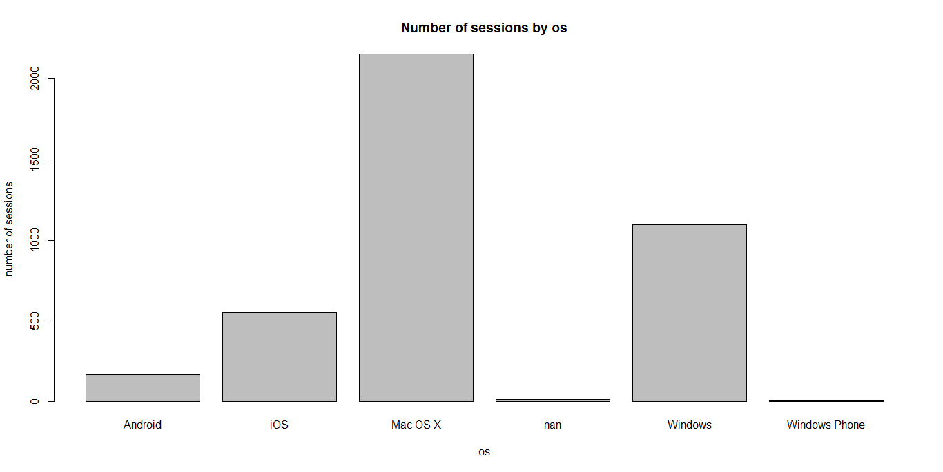
OS

Slide 3
OS
 | Mac OS X | Windows | iOS | Android | Windows Phone | NA
Number of users | 337 | 188 | 167 | 48 | 1 | 2
Number of sessions | 2155 | 1098 | 551 | 166 | 1 | 12
Sessions per user | 6.4 | 5.84 | 3.3 | 3.45 | 1 | 6

Slide 4
OS
Mac OS X has been used the most (337 users), double number of Windows users. Mac OS X also has highest number of sessions per user
=> Mac users play a crucial role
83% sessions were conducted on desktops/laptops rather than mobiles.
=> Mobile has some advantages over desktops, e.g mobility, flexibility. It would be great if we can engage more mobile users to use the app.

Slide 5
OS
What differs desktop/laptop users from mobile users?

Slide 6
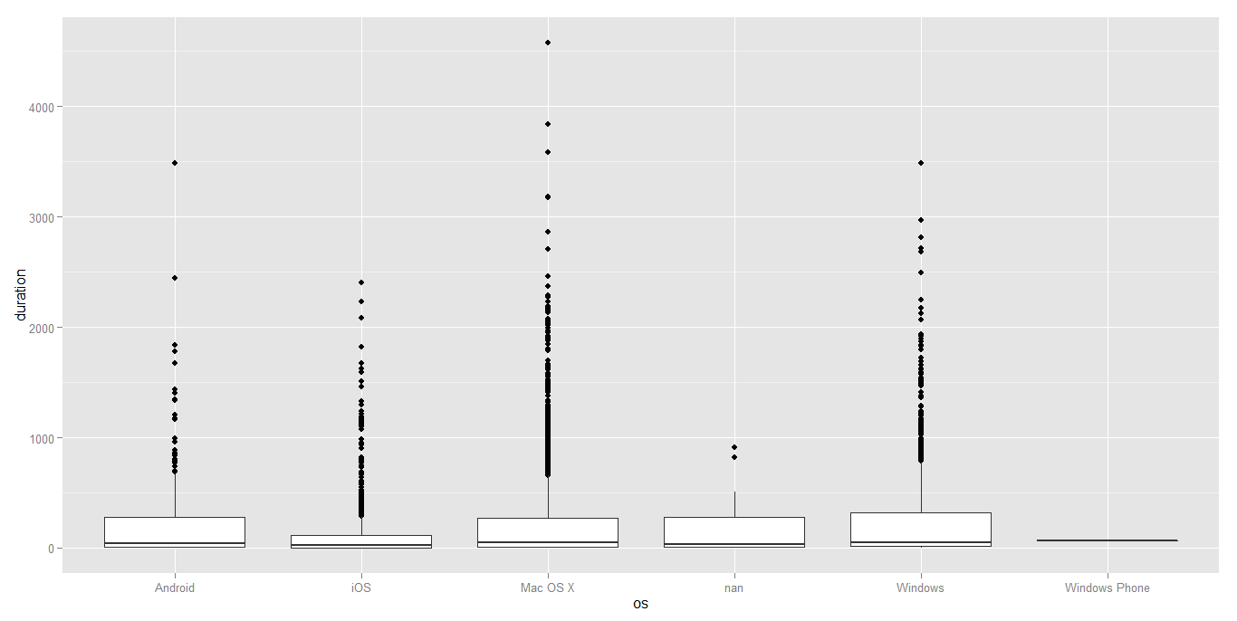
OS
Boxplot shows sessions length for different OS

Slide 7
OS
 | Mac OS X | Windows | iOS | Android
Mean of sessions length | 4 mins | 4.3 mins | 2.65 mins | 4.5 mins
% sessions > 10mins | 15% | 15.5% | 7.8% | 17.4%
% sessions > 15 mins | 9.3% | 9.6% | 4.7% | 8.4%
% sessions > 30 mins | 1.63% | 1.55% | 0.8% | 0.9%

Slide 8
OS
Difference 1:
Longest sessions usually belong to desktop/laptop users.
=> Desktop/laptop is preferred for long sessions. In contrast, mobile users use devices for short browsing.

Slide 9
OS
Difference 2:
73% of laptop users view content after opening folder. This number of mobile users is just 65%.
6% iOS users spend more than 5 minutes on viewing contents. More than 10% Windows and Mac users do the same (big screen preferred when viewing lectures).
Ratio of mobile users view announcements higher than laptop users.
=> Viewing contents is preferred on laptops while viewing announcements is preferred on mobiles.

Slide 10
Summary
Majority of users are desktop/laptop users, especially Mac OS X
Laptop users seem to have longer sessions and longer duration viewing contents. They are more active than mobile users group.
Viewing contents is preferred on laptops while viewing announcements is preferred on mobiles.

